Slide 1
Scoil Ghormáin Naofa
Uniform Survey – March 2015

Slide 2
Summary:
Survey open to all parent for two weeks.
61% participation Rate (based on 70 families)
Survey focused on ascertaining information in four main areas: Satisfaction, Quality, Colour and Price of current uniform
Fading of fabric is most common issue raised throughout the survey.
Sentiments raised that current uniform is not a positive representation of the school.

Slide 3
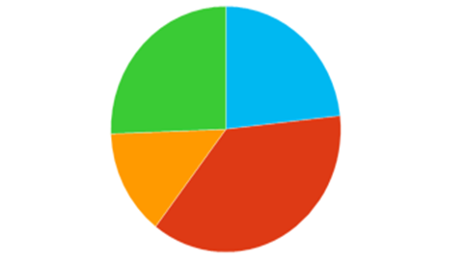
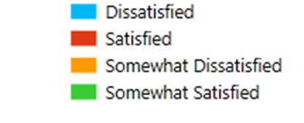
Satisfaction with current uniform
63% of respondents showed some level of dissatisfaction with the current uniform
37% Satisfied
26% Somewhat Satisfied
23% Dissatisfied
14% Somewhat dissatisfied

Slide 4
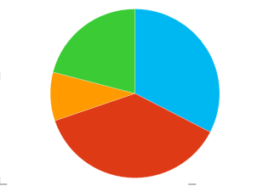
Quality of current uniform
63% of respondents showed some level of dissatisfaction with the quality of current uniform
37% Satisfied
21% Somewhat Satisfied
33% Dissatisfied
9% Somewhat Dissatisfied
Clear association between fading of current uniform and quality
See Slide 9 for additional comments on Quality

Slide 5
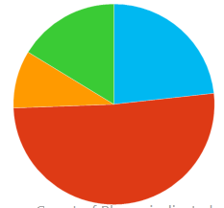
Colour of current uniform
49% of respondents showed some level of dissatisfaction with the Colour of current uniform
51% Satisfied with colour
Fading raised as main issue as opposed to colour itself
See Slide 10 for additional comments on Colour

Slide 6
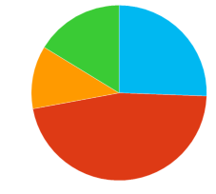
Price of current uniform
53% of respondents showed some level of dissatisfaction with the Price of the current uniform
47% Satisfied with price of current uniform
Clear association between price & quality of current uniform.
See slide 11 for additional comments on Price.

Slide 7
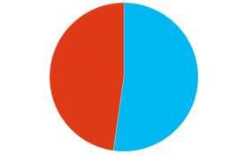
Preference to Change current uniform
48% of respondents would like to CHANGE the current uniform whole 52% would NOT.
Combination of formal uniform and tracksuit is most dominate option for change.

Slide 8
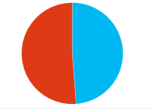
Preference to Buy online
49% of respondents are LIKELY to buy online while 51% are UNLIKELY.

Slide 9
Summary of comments on QUALITY

Slide 10
Summary of comments on COLOUR

Slide 11
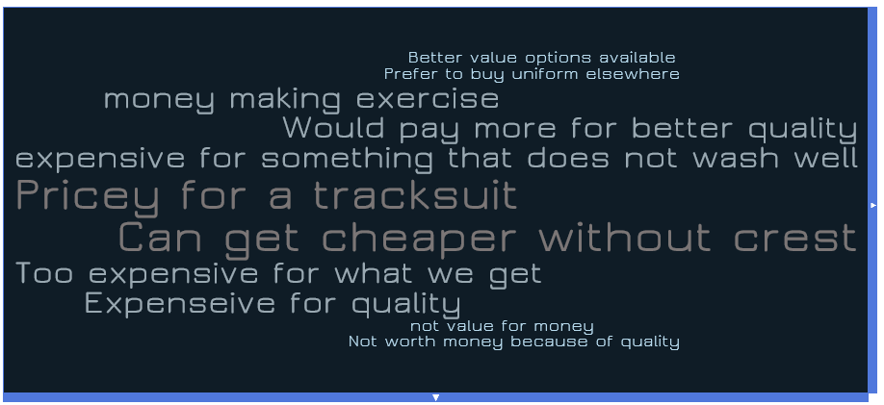
Summary of comments on PRICE

Slide 12
Thank You

